Slide 1
AI Automated Checkout
Luke Herbst
Final Machine learning Project
Coderschool VN

Slide 2
What is does ?
Person’s info
Load into database
Place items
Take video +
Object detection
Pay
Database update
Inputs->
Process ->

Slide 3
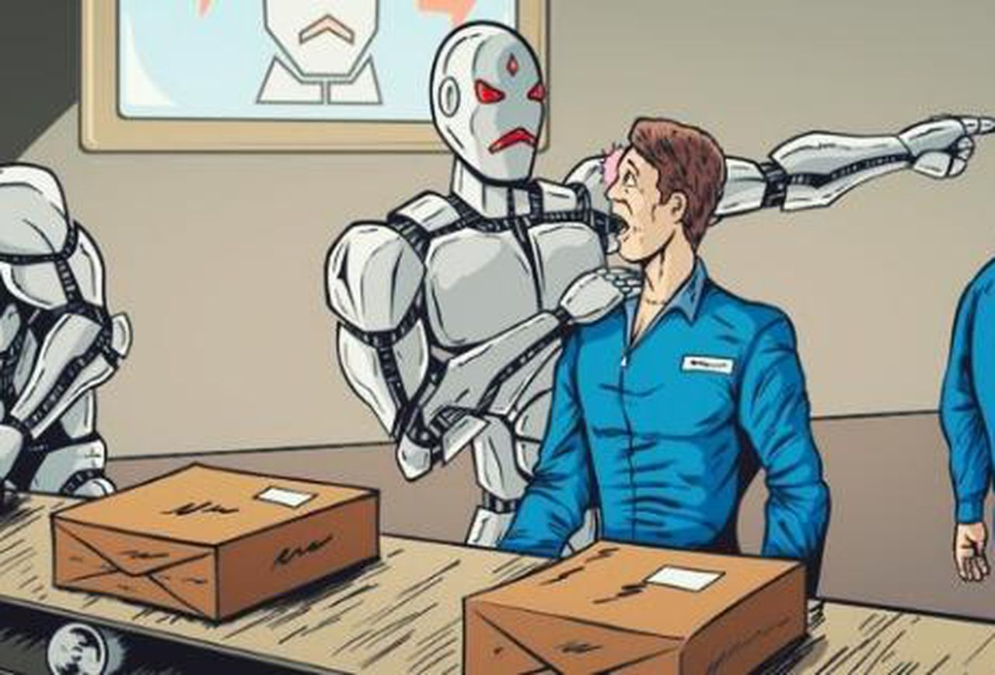
Why ?
If you can’t beat em, join em.

Slide 4
DEMO TIME
To Luke:
Turn off your camera on ohyay!

Slide 5
How ?

Slide 6
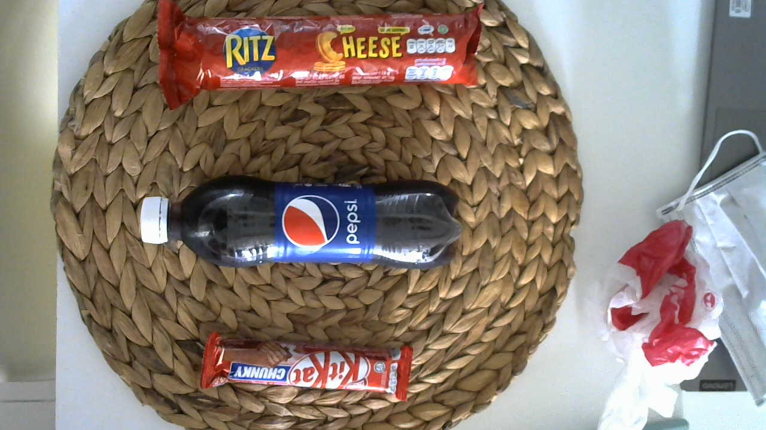
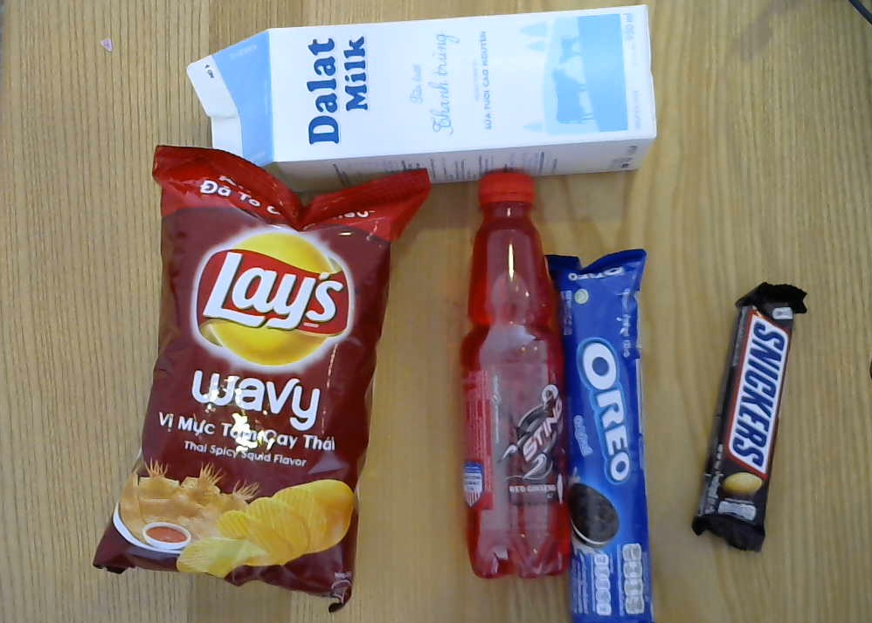
The DATA !

Slide 7
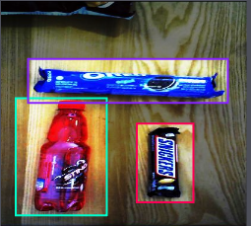
Data preprocessing
700 images
Draw bounding boxes
Label boxes
Resize images
I used Roboflow to help get the data into the correct format

Slide 8
Technical
Custom YOLOv4 model
OpenCV
Sqlite3

Slide 9
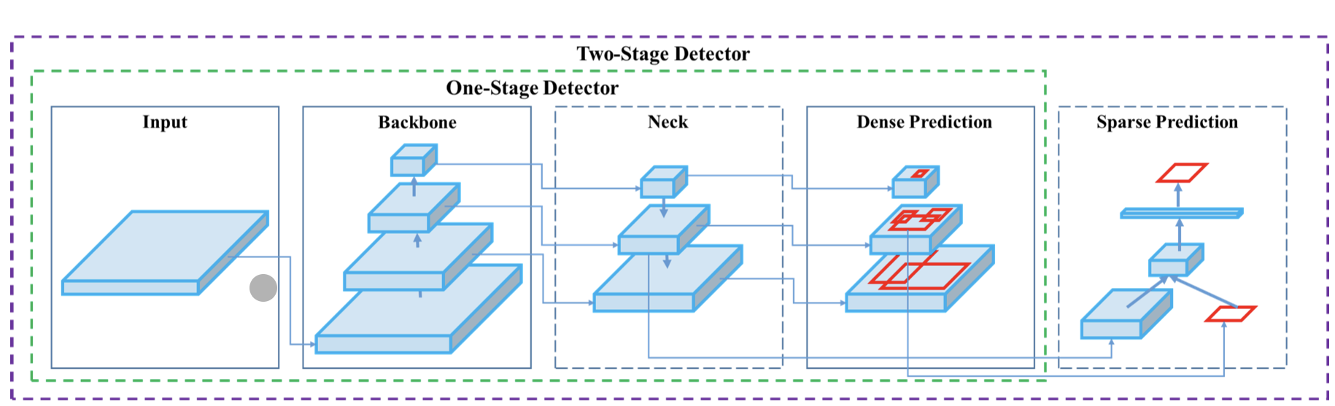
YOLO object detection
CSPDARKNET53 PANET Layers 86, 96,106
outputs

Slide 10
Training results
Model | Mean Average Precision | Training time on google colab (Tesla T4 GPU)
Yolov4 | 98.57% | 3 hours
YOLO V4 Tiny | 98.63% | 30 minutes

Slide 11
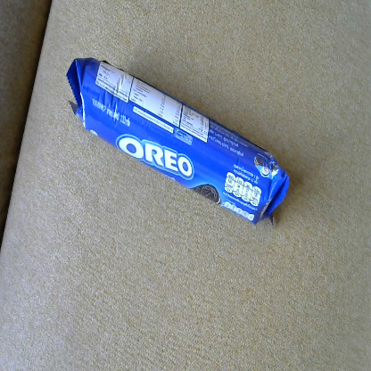
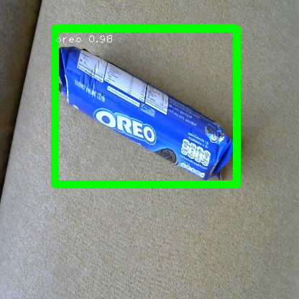
OpenCV
yolo
x 10 000
1.Loop through the boxes
2. If Probability of class n is > 0.7 keep the box
3. Non-max suppression on remaining boxes
4. draw the boxes and write the label

Slide 12
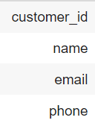
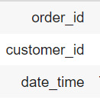
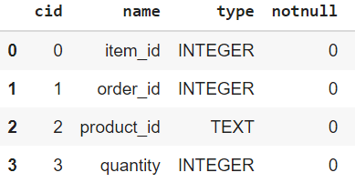
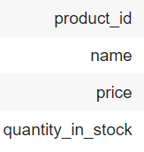
Database
Customers
Orders
Order items
Products

Slide 13
Future work
More items
Optimize prediction speed
Streamline the process of adding new products
Add feature: auto email, more database tables.
Consider security

Slide 14
References
Roboflow website - https://roboflow.com/
Yolov4 - https://arxiv.org/abs/2004.10934
https://becominghuman.ai/explaining-yolov4-a-one-stage-detector

Slide 15
Thanks for listening

Slide 16
Extra Slides

Slide 17
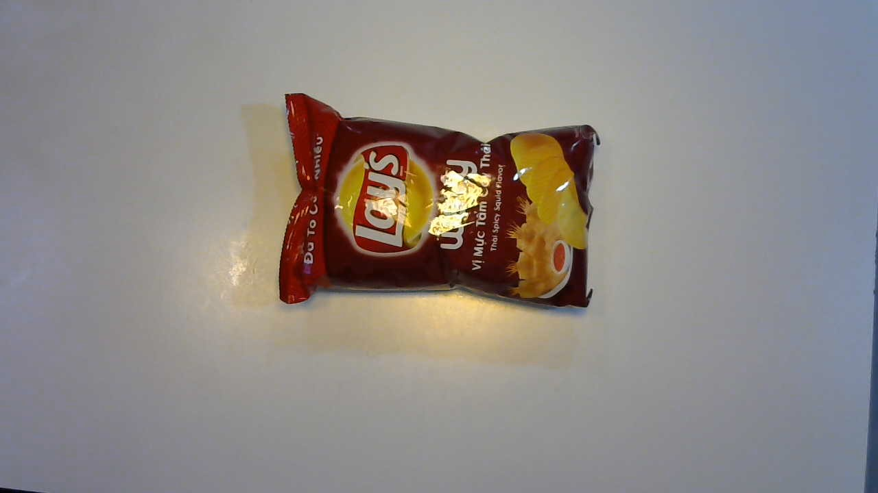
YOLO continued..
Input :416 x 416
Yolo detection layers
13x13 = 507 boxes
26x26 = 2028 boxes
52x52 = 8112 boxes

Slide 18
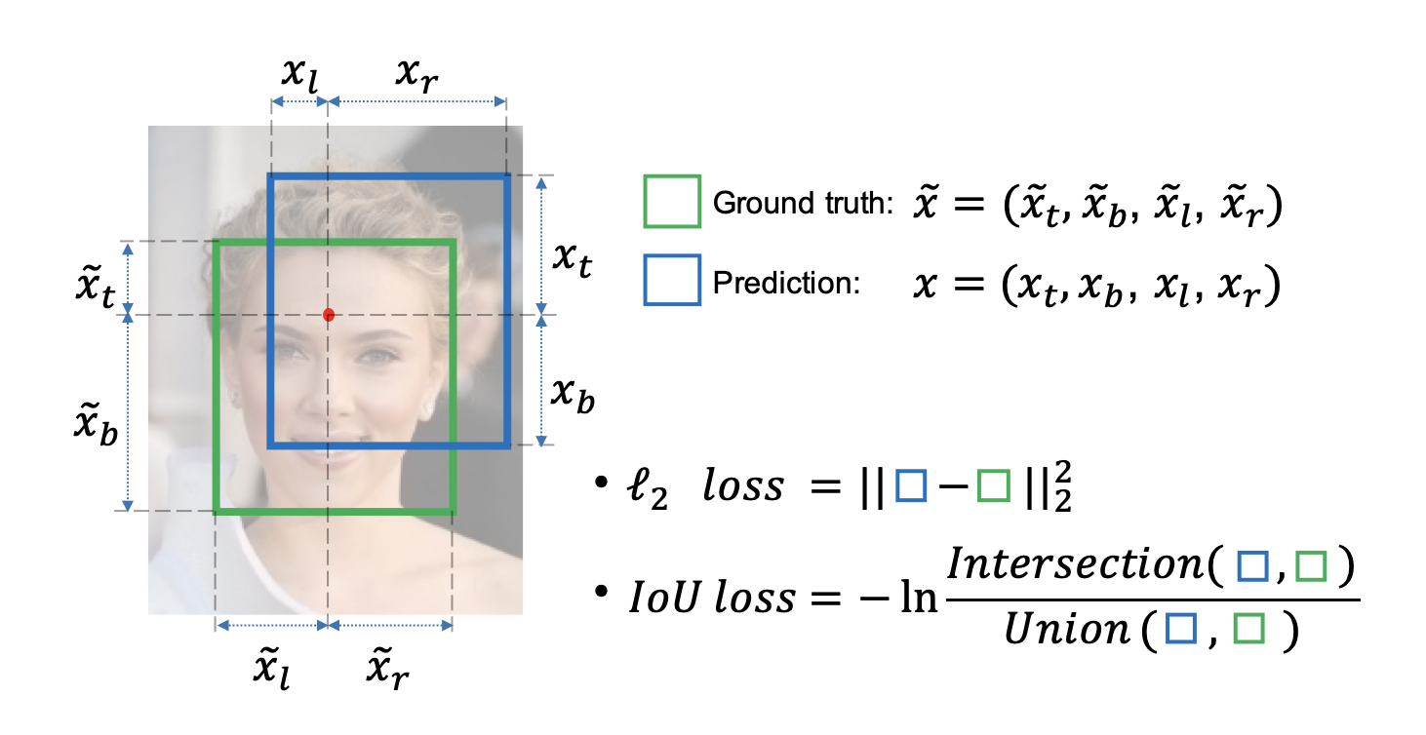

Loss function
CIOU
Yolo outputs

Slide 19
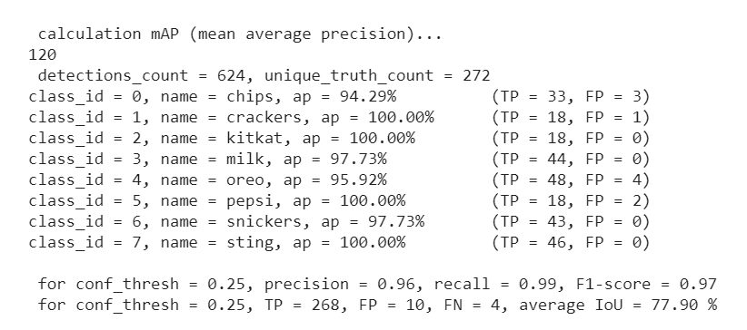
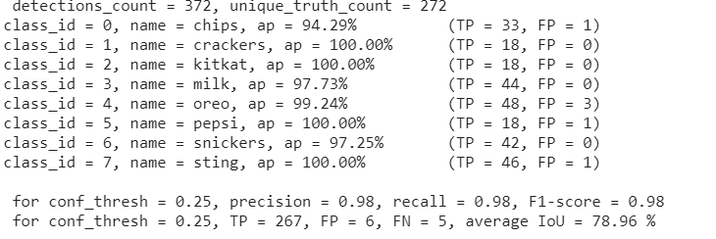
Training results
Yolo v4
Yolo v4 Tiny

